Slide 1
Context diagram
The BIG picture

Slide 2
What is it?
A diagram that shows a high level view of the system
Shows relationship with partners
other systems, organizational groups, actors, external data stores…
To be used at the proper level to show relevant information
What do we need to know / remember while thinking about the system?
What is hidden by the details, but important to remember?
AD, Exchange: important because other systems and users interact with them.
J1, J6, other personnel : because SMP and its related systems have major impact on their lives.

Slide 3
What make a context diagram?
Process
High level : the system under scrutiny
Low level : the task (as part of the system)
External Entity (Partners)
System, organization, user
Data flow
What is transiting between partners
ATTENTION:
it is not the shape that are used that is important, it is the possibility to engage conversation.
SMP
Add User
J6
User info

Slide 4
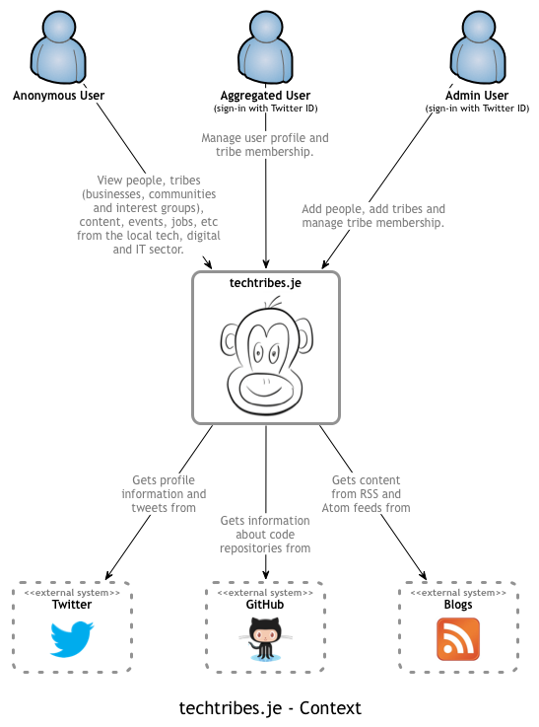
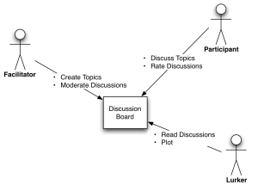
Examples

Slide 5
What next?
Know that it exists to help communicate and collaborate to build a shared knowledge.
Use it at the level that fit the current context.
Make sure you use the shapes consistently.
It is the language you use to communicate.

